Slide 1
COMP30024
Artificial Intelligence
Week3 Tutorial

Slide 2

Project Part A Released!

Slide 3
Weekly Topic Review
Searching Strategies are evaluated along the following dimensions:
  completeness—does it always find a solution if one exists?
  time complexity—number of nodes generated/expanded
  space complexity—maximum number of nodes in memory
  optimality—does it always find a least-cost solution?
Time and space complexity are measured in terms of
  b—maximum branching factor of the search tree
  d—depth of the least-cost solution
  m—maximum depth of the state space (may be ∞)

Slide 4
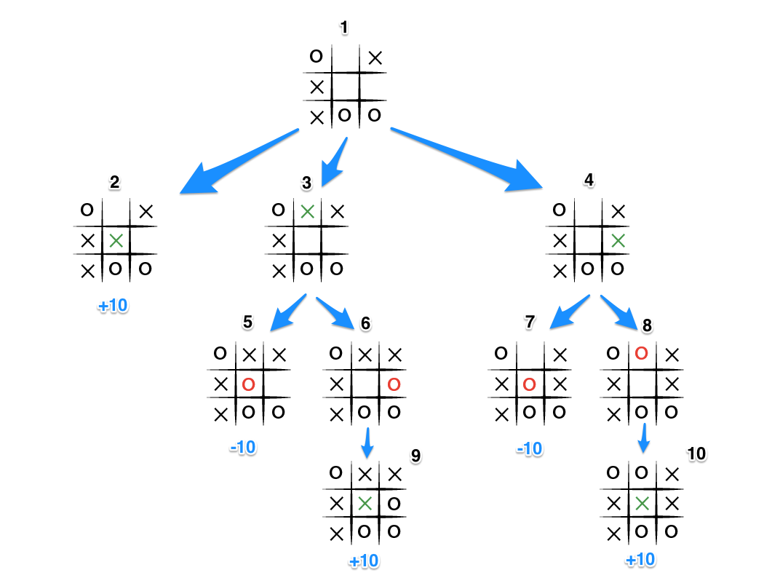
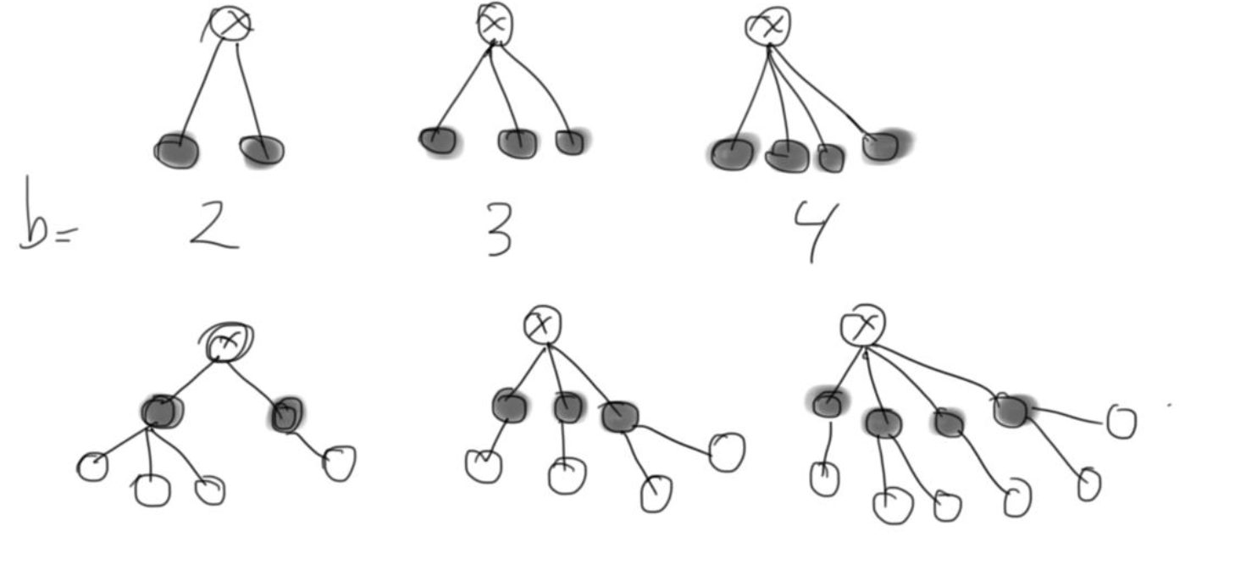
Weekly Topic Review
b—maximum branching factor of the search tree

Slide 5
Weekly Topic Review
Uninformed search methods
  Also called blind search or unguided search, is a class of general purpose search algorithms that operate in a brute-force way
  limited to taking actions and performing a goal test, and do not have access to any further domain knowledge
  E.g. Breadth-first search, Depth-first search, Iterative deepening depth-first search, Bidirectional search

Slide 6
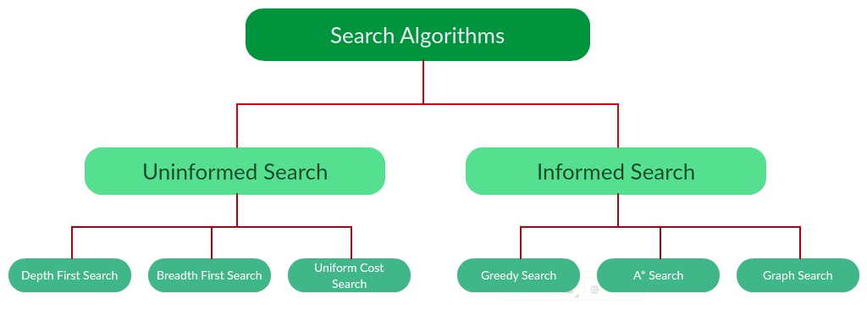
Weekly Topic Review
Informed search methods
  If information is available about the problem this could guide the search (for example in finding the shortest route in a map: information about distances between places on map)
  Information is put in an evaluation function f(n) to be able to give a value to each state.
  E.g. Greedy Search, A* Search

Slide 7

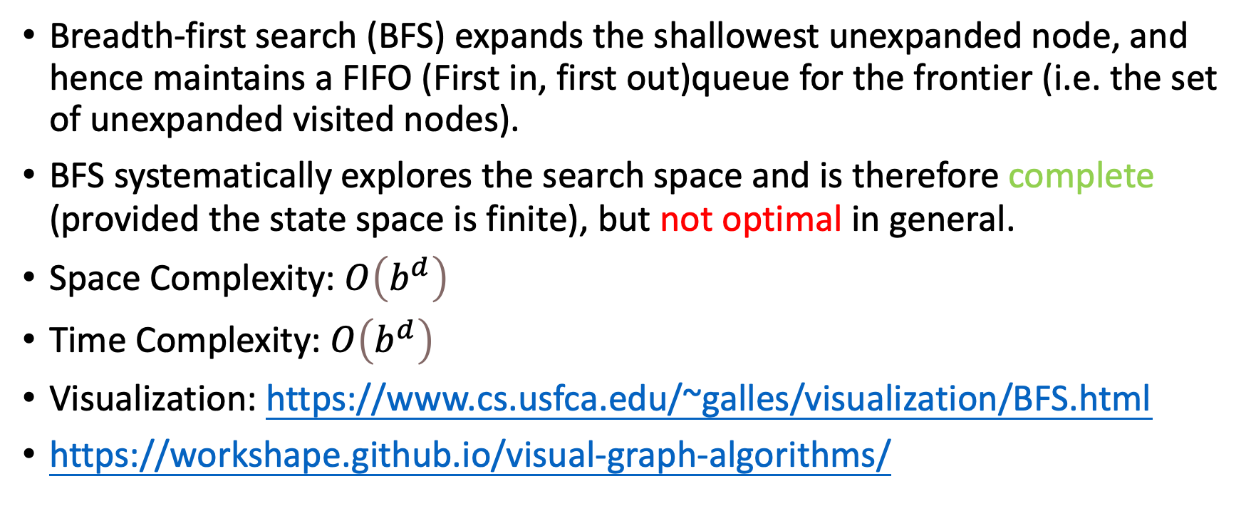
Breadth-first search (BFS)
Breadth-first search (BFS) expands the shallowest unexpanded node, and hence maintains a FIFO (First in, first out)queue for the frontier (i.e. the set of unexpanded visited nodes).
BFS systematically explores the search space and is therefore complete (provided the state space is finite), but not optimal in general.
Space Complexity: $O\left(b^{d}\right)$
Time Complexity: $O\left(b^{d}\right)$
Visualization: https://www.cs.usfca.edu/~galles/visualization/BFS.html
https://workshape.github.io/visual-graph-algorithms/

Slide 8
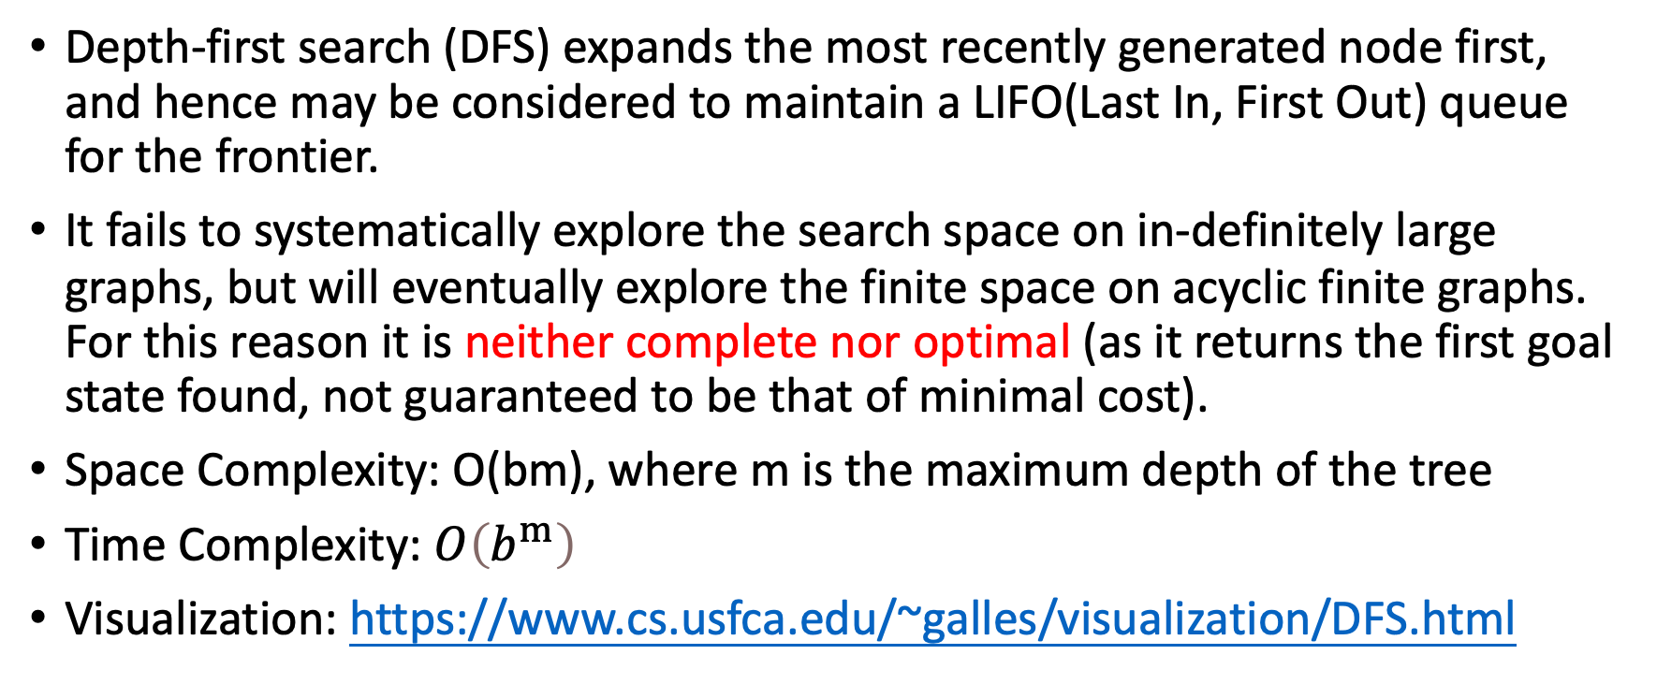
Depth-first search (DFS)
Depth-first search (DFS) expands the most recently generated node first, and hence may be considered to maintain a LIFO(Last In, First Out) queue for the frontier.
It fails to systematically explore the search space on in-definitely large graphs, but will eventually explore the finite space on acyclic finite graphs. For this reason it is neither complete nor optimal (as it returns the first goal state found, not guaranteed to be that of minimal cost).
Space Complexity: O(bm), where m is the maximum depth of the tree
Time Complexity: $O\left(b^{m}\right)$
Visualization: https://www.cs.usfca.edu/~galles/visualization/DFS.html

Slide 9
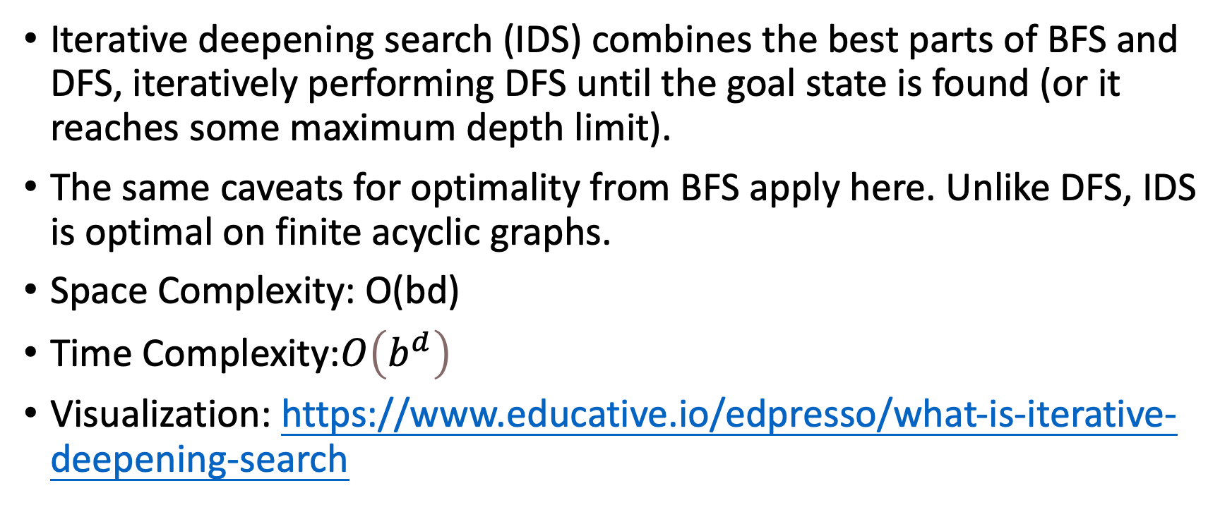
Iterative deepening search (IDS)
Iterative deepening search (IDS) combines the best parts of BFS and DFS, iteratively performing DFS until the goal state is found (or it reaches some maximum depth limit).
The same caveats for optimality from BFS apply here. Unlike DFS, IDS is optimal on finite acyclic graphs.
Space Complexity: O(bd)
Time Complexity:$O\left(b^{d}\right)$
Visualization: https://www.educative.io/edpresso/what-is-iterative-deepening-search

Slide 10
Problems
Question 1 (b)
Question 2
Question 4

Slide 11
Problem 1 Toy Graphs
In BFS and DFS, a node is marked generated when it is first discovered, then marked expanded when its successor states have been generated. At any given moment, several nodes might simultaneously be in the generated (but not yet expanded ) state.
(a) Describe a graph on n vertices and root v such that Θ(n) nodes are simultaneously in the discovered state when conducting BFS starting from v.
(b) Repeat part (a), but for DFS.

Slide 12
Problem 1 Toy Graphs
This statement explains the two key states of nodes during Breadth-First Search (BFS) and Depth-First Search (DFS) traversal:
Generated: A node is marked as generated when it is first discovered (added to the search frontier).
Expanded: A node is marked as expanded once all of its successor nodes have been generated.

Slide 13
Problem 1 Toy Graphs
This statement explains the two key states of nodes during Breadth-First Search (BFS) and Depth-First Search (DFS) traversal:
Generated: A node is marked as generated when it is first discovered (added to the search frontier).
Expanded: A node is marked as expanded once all of its successor nodes have been generated.

Slide 14
Problem 1 Toy Graphs
v
If we apply BFS starting from v:
v is generated first.
v is then expanded, meaning its successors (a and b) are generated.
a and b are now in the generated state until BFS expands them.
a
b
c
d

Slide 15
Problem 1 Toy Graphs
v
If we apply DFS starting from v:
v is generated first.
DFS expands v immediately, generating only one child (a).
a is then expanded before b is even generated.
a
b
c
d

Slide 16
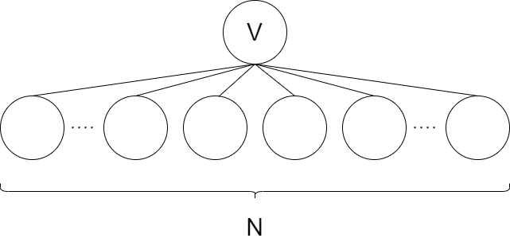
Problem 1 Toy Graphs
In BFS and DFS, a node is marked generated when it is first discovered, then marked expanded when its successor states have been generated. At any given moment, several nodes might simultaneously be in the generated (but not yet expanded ) state.
(a) Describe a graph on n vertices and root v such that Θ(n) nodes are simultaneously in the discovered state when conducting BFS starting from v.
A graph of depth 1 where v has n children.

Slide 17
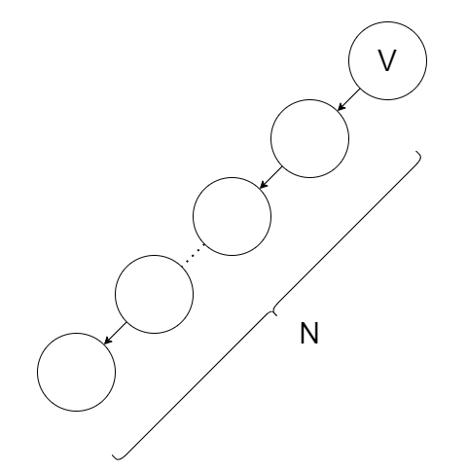
Problem 1 Toy Graphs
In BFS and DFS, a node is marked generated when it is first discovered, then marked expanded when its successor states have been generated. At any given moment, several nodes might simultaneously be in the generated (but not yet expanded ) state.
(b) Describe a graph on n vertices and root v
such that at most one node is ever in the
generated state when conducting DFS
starting from v.
A graph of depth n with a single linear
branch of children extending from v.

Slide 18
Summary of BFS and DFS
Algorithm | Expansion Behavior | Generation Behavior | Impact of Graph Structure
BFS | Expands in layers, exploring all neighbors at the current level before moving deeper | Multiple nodes are generated simultaneously in each layer | Affects how many nodes are generated at once—wide trees generate more at each level
DFS | Expands deeply, following a single path until reaching the end before backtracking | At most one node is generated at a time | Graph depth affects how many nodes remain ungenerated while others are expanded

Slide 19
Problem 2 Iterative Deepening
Recall the iterative deepening search (IDS) strategy from lectures.
(a) Derive the time complexity of iterative deepening search on a graph with branching factor b and minimum goal depth d.
(b) Can you think of a situation where IDS performs much worse than regular depth-first search?
(c) BFS and IDS are not optimal in general. State a necessary condition on the cost function g : paths → R for both methods to be optimal.

Slide 20
Problem 2 Iterative Deepening
Recall the iterative deepening search (IDS) strategy from lectures.
(a) Derive the time complexity of iterative deepening search on a graph with branching factor b and minimum goal depth d.

Slide 21
Problem 2 Iterative Deepening
Recall the iterative deepening search (IDS) strategy from lectures.
(a) Derive the time complexity of iterative deepening search on a graph with branching factor b and minimum goal depth d.
D = 0
d * b^0

Slide 22
Problem 2 Iterative Deepening
Recall the iterative deepening search (IDS) strategy from lectures.
(a) Derive the time complexity of iterative deepening search on a graph with branching factor b and minimum goal depth d.
D = 1
d*b^0 + (d-1)*b^1

Slide 23
Problem 2 Iterative Deepening
Recall the iterative deepening search (IDS) strategy from lectures.
(a) Derive the time complexity of iterative deepening search on a graph with branching factor b and minimum goal depth d.
D = 2
d*b^0 + (d-1)*b^1 + (d-2)*b^2

Slide 24
Problem 2 Iterative Deepening
Recall the iterative deepening search (IDS) strategy from lectures.
(a) Derive the time complexity of iterative deepening search on a graph with branching factor b and minimum goal depth d.
D = d
d*b^0 + (d-1)*b^1 + (d-2)*b^2 …+b^d
Nodes at all levels apart from d are
re-generated multiple times

Slide 25
Problem 2 Iterative Deepening
Recall the iterative deepening search (IDS) strategy from lectures.
(a) Derive the time complexity of iterative deepening search on a graph with branching factor b and minimum goal depth d.
D = d
d*b^0 + (d-1)*b^1 + (d-2)*b^2 …+b^d
Total time complexity:

Slide 26
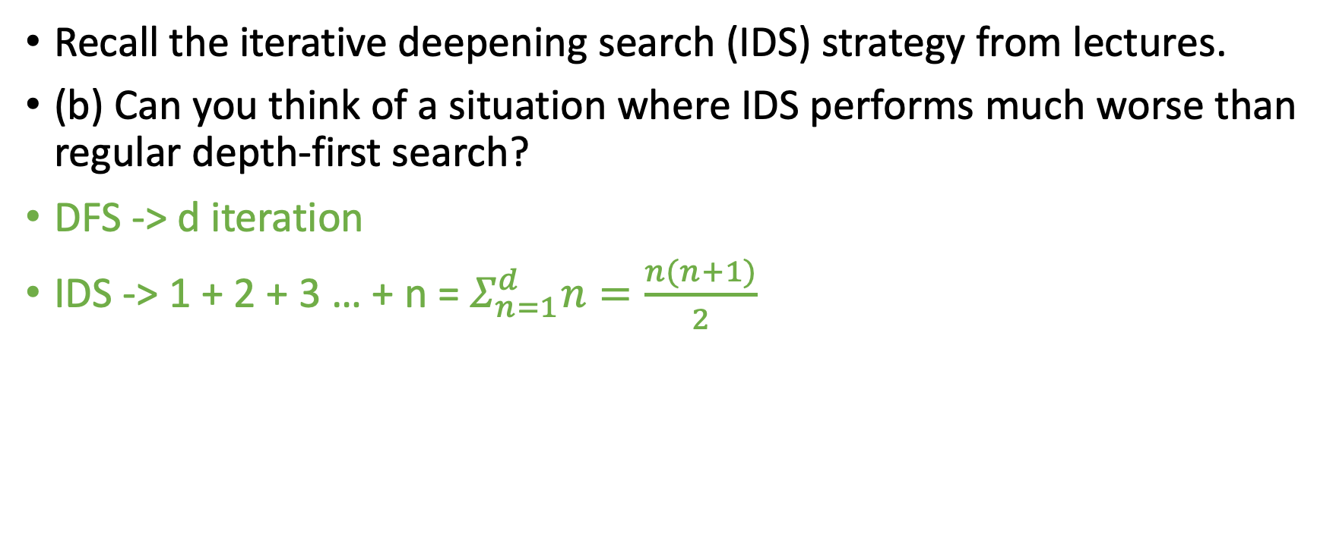
Problem 2 Iterative Deepening
Recall the iterative deepening search (IDS) strategy from lectures.
(b) Can you think of a situation where IDS performs much worse than regular depth-first search?
DFS -> d iteration
IDS -> 1 + 2 + 3 … + n = $Σ_{n=1}^{d}n=\frac{n(n+1)}{2}$

Slide 27
Problem 2 Iterative Deepening
(c) BFS and IDS are not optimal in general. State a necessary condition on the cost function g : paths → R for both methods to be optimal.
Why BFS and IDS May Not Be Optimal？
BFS and IDS only care about the number of steps (path depth).
They always choose the shortest path in terms of steps, but not necessarily the lowest-cost path.
If longer paths have a lower cost, BFS and IDS may select the wrong path.

Slide 28
Problem 2 Iterative Deepening
(c) BFS and IDS are not optimal in general. State a necessary condition on the cost function g : paths → R for both methods to be optimal.
Necessary Condition: Cost Should Not Decrease
If a path gets cheaper as it gets longer, BFS and IDS might make a mistake.
To guarantee that BFS and IDS always find the optimal path, the cost function must be "non-decreasing."
  This means that going deeper should not result in a lower cost.
  The cost can stay the same or increase, but never decrease.

Slide 29
Problem 2 Iterative Deepening
(c) BFS and IDS are not optimal in general. State a necessary condition on the cost function g : paths → R for both methods to be optimal.
Cost: 3
If longer paths are cheaper, BFS and IDS may fail
To ensure BFS and IDS are optimal, the path cost must never decrease as depth increases.
Cost: 5
Notes:
BFS and IDS always pick the shortest route (2 steps, $5).
But the longer route (4 steps, $3) is actually cheaper!
BFS and IDS fail to find the best (cheapest) path because they do not check cost.

Slide 30
Problem 4 Directed Graphs
Your tutor’s job is to arrange n ill-behaved children in a straight line, facing front. They are given a list of m statements of the form ”child i hates child j”. If i hates j, they cannot put i somewhere behind j, because i is then capable of throwing something at j.
(a) They have enlisted your help to design an algorithm which orders the line (or says it is not possible), using depth-first search. Formulate this problem as a graph algorithm and analyze its running time.
(b) For the class photo, the children must be arranged in rows such that if i hates j, i must be in a lower-numbered row than j, otherwise it is possible for i to drop something on j. Design an efficient algorithm to find the minimum number of rows needed

Slide 31
Problem 4 Directed Graphs
Your tutor’s job is to arrange n ill-behaved children in a straight line, facing front. They are given a list of m statements of the form ”child i hates child j”. If i hates j, they cannot put i somewhere behind j, because i is then capable of throwing something at j.
Vertices = Children
Edges (i → j) = "i hates j" (i must be placed before j)
If the graph contains a cycle → No valid ordering exists!
I
J

Slide 32
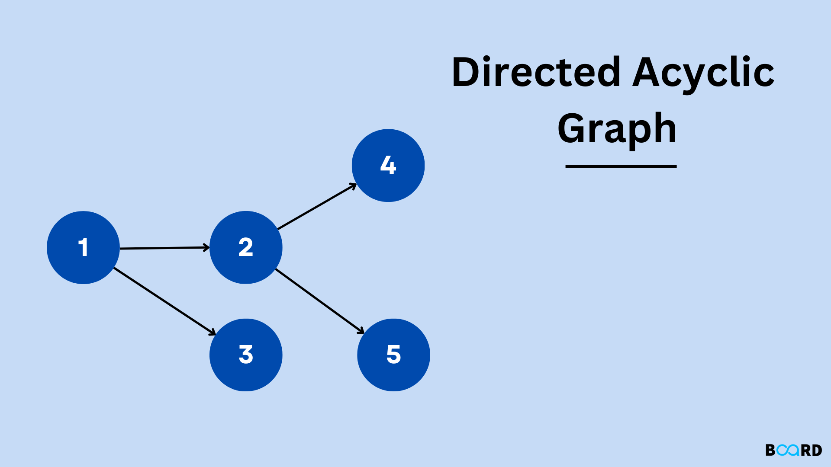
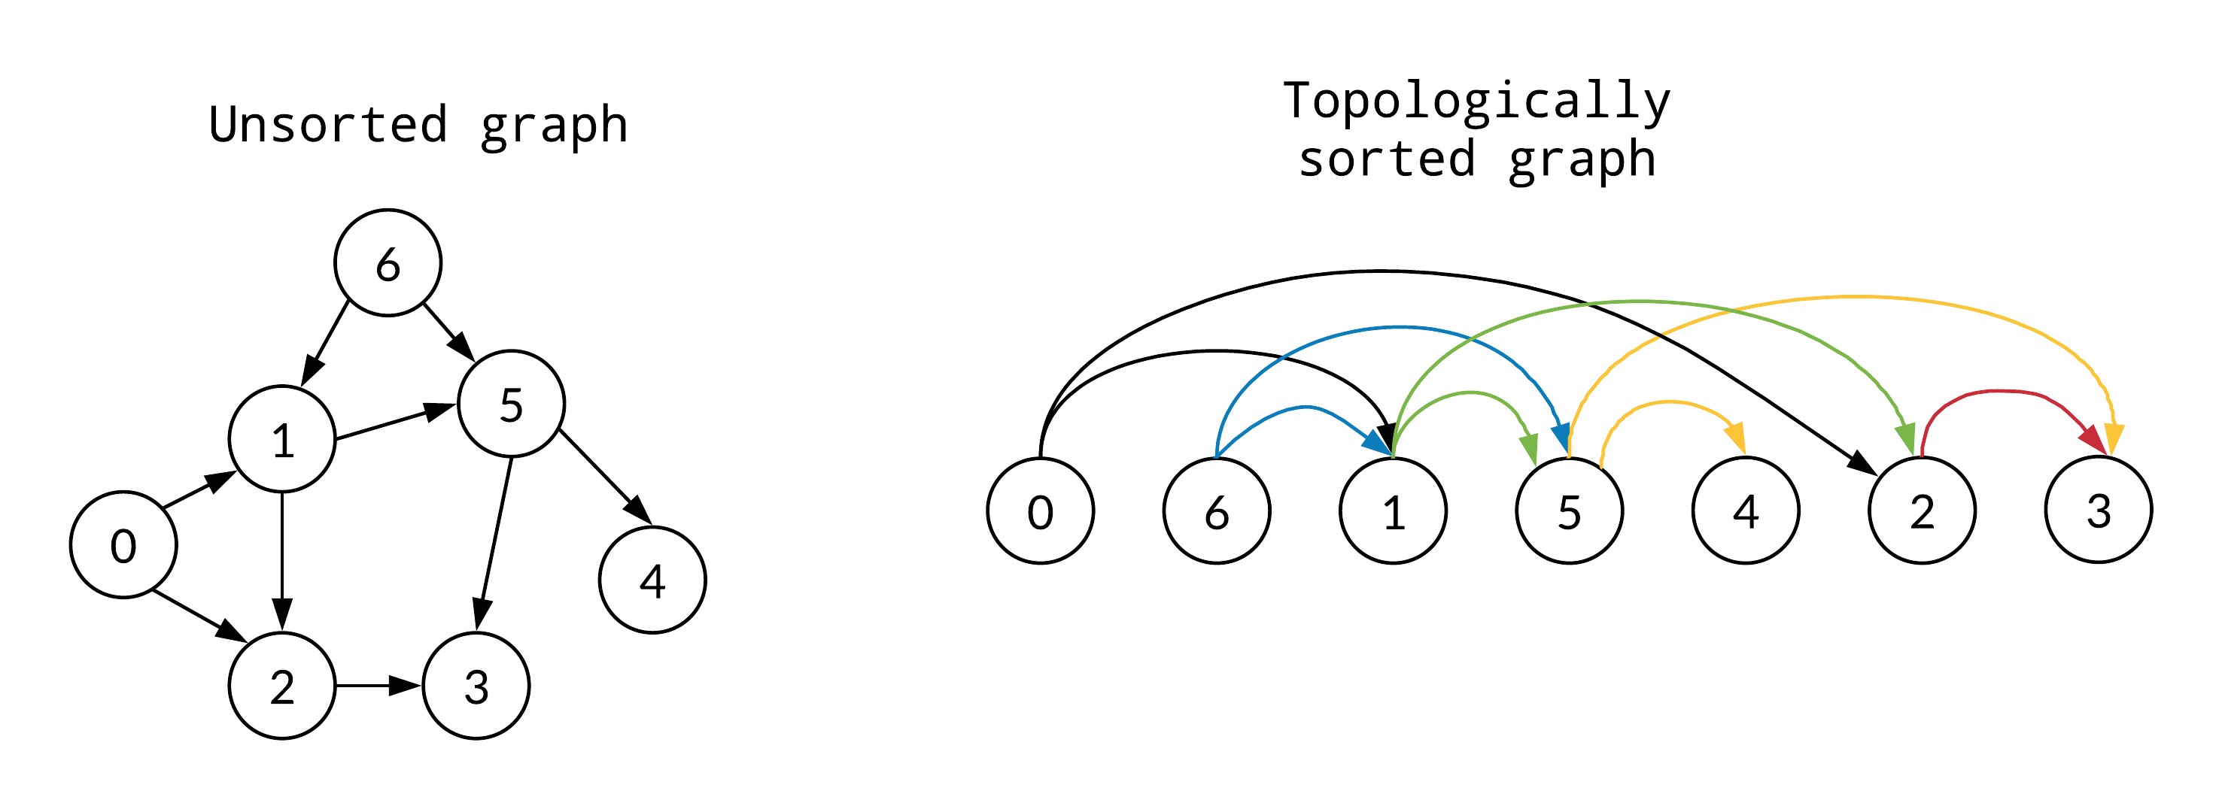
Problem 4 Directed Graphs
Step 1: Convert the problem into a DAG (Directed Acyclic Graph).
Step 2: Perform Topological Sorting using DFS:
  Use a stack to store sorted nodes.
  Perform DFS and push nodes onto the stack only after processing all descendants.
  Pop nodes from the stack to get the correct order.
Key Insight:
This ensures that if i hates j, then i always appears before j in the final order.
Time Complexity: O(m + n)

Slide 33
Problem 4 Directed Graphs
A valid ordering only exists if the graph is a DAG.
If the graph has a cycle, it means there’s a contradiction (e.g., i→j→k→i ).
In this case, ordering is impossible.
Check this for demo https://www.youtube.com/watch?v=n_yl2a6n7nM

Slide 34
Project Discussion

